Slide 1
Nested Statement Conditions

Slide 2
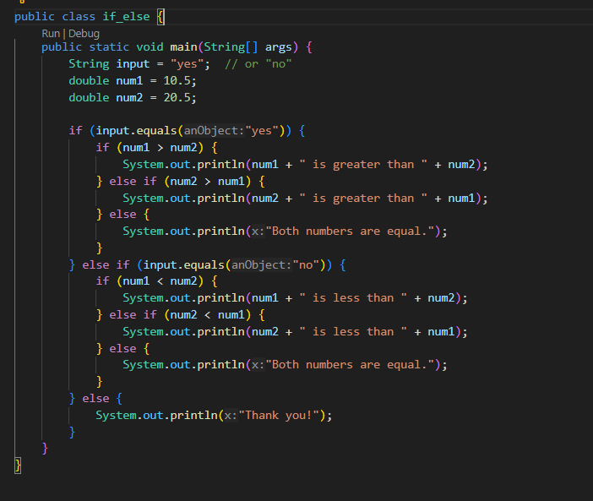
In Java……..

Slide 3
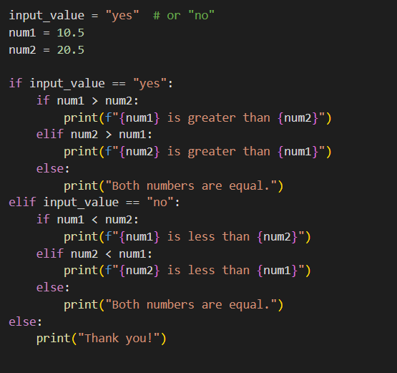
In Python………..

Slide 4
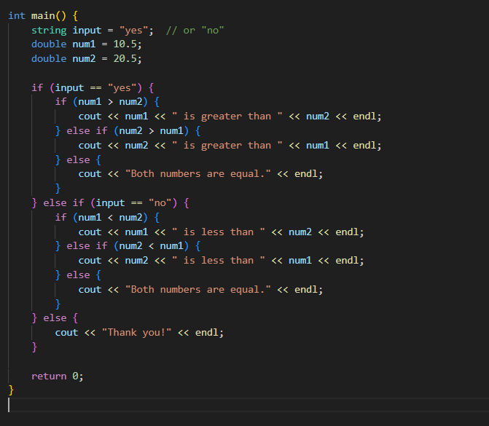
In C++…….

Slide 5
Tasks……….
Develop a program that utilizes nested conditional statements. If the user inputs "yes", the subsequent statement should compare two decimal numbers to determine which one is larger. If the user inputs "no", the program should determine which number is smaller. If any other input is provided, the program should output "thank you.“
Write a program that prompts the user to enter two numbers. If the sum of the numbers is greater than 100, check if the product of the numbers is even or odd. If the sum is less than or equal to 100, check if the first number is greater than, less than, or equal to the second number.
Write a program that asks the user to enter a grade (A, B, C, D, or F). If the grade is A, print "Excellent". If the grade is B or C, check if the user wants to improve the grade. If the user wants to improve, print "Good luck". If the grade is D or F, check if the user wants to repeat the course. If the user wants to repeat, print "Study harder next time".
Write a program that prompts the user to enter a season (spring, summer, autumn, or winter). If the season is summer, check if the user likes hot weather. If the user likes hot weather, print "Go to the beach". If the season is winter, check if the user likes cold weather. If the user likes cold weather, print "Go skiing". If the season is spring or autumn, print "Enjoy the pleasant weather“.

Slide 6
Optional………………
A company provide a service on hourly basis and the hourly charges is 4 dollars, But the policy of company is that any customer required service for 7 hours so company received charges of full day service that amount is 30 dollars. If any customer will pay full day charges so company also recived 10% tax of total payment. Note customer provide date and time of their availability.
Create a Rock, Paper, and Scissor game using statements

